Slide 1
R for Libraries
Session 2: Data Exploration
Clarke Iakovakis
Scholarly Communications Librarian
University of Houston-Clear Lake
This work is licensed under a Creative Commons Attribution 4.0 International License.

Slide 2
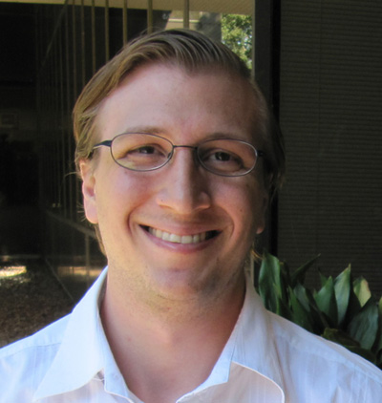
About me
Scholarly Communications Librarian at the University of Houston-Clear Lake

Slide 3

Outline for Today
R Packages
Getting data into R
Exploring your data

Slide 4
This will (still) be overwhelming!
Refer to the handouts and help resources provided in Session 1 and stick with it!

Slide 5
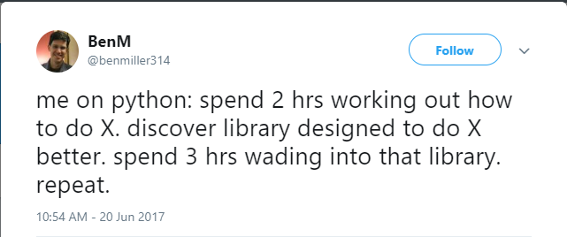
Packages
Users write their own function libraries and release them as R Packages.
https://twitter.com/benmiller314/status/877223260265615360

Slide 6
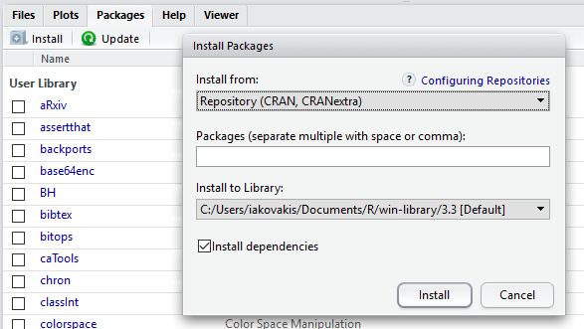
Packages
To install
Click on Packages > Install
Or type directly in the console:
> install.packages("dplyr")

Slide 7
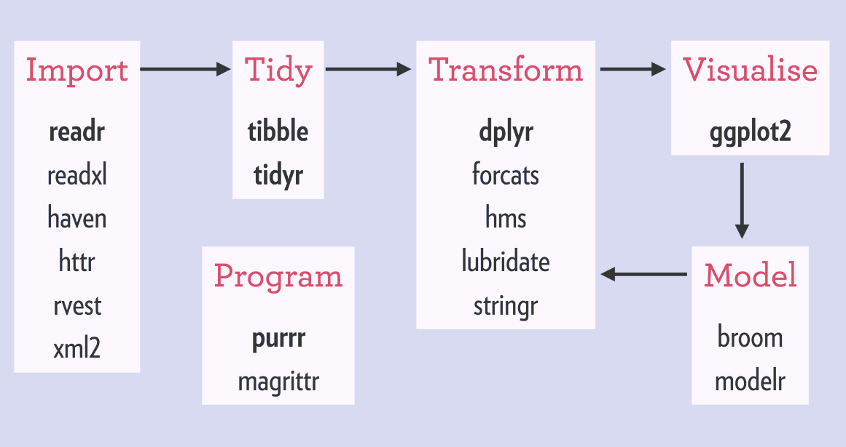
Packages
Install this helpful package of packages:
> install.packages("tidyverse")
The tidyverse is "a coherent system of packages for data manipulation, exploration and visualization that share a common design philosophy"
Are you getting error message Warning: unable to move temporary installation ?
It’s possibly due to antivirus protection. Install directly from R (as opposed to R Studio) or see
https://stackoverflow.com/a/44256520
https://stackoverflow.com/a/23167680
Image by Joseph Rickert, "What is the tidyverse?" https://rviews.rstudio.com/2017/06/08/what-is-the-tidyverse/

Slide 8
Packages
Installing tidyverse giving you trouble? Just install these for now:
> install.packages("dplyr")
> install.packages("readxl")
> install.packages("stringr")
> install.packages("ggplot2")

Slide 9
Packages
After installing a package, you must load it into your R session
> select(books, SUBJECT)
Error: could not find function "select"
> library("tidyverse")

Slide 10
Reading data into R
When you read a file into R, you must save it as an object. In other words, create a copy of it in R’s working memory.
When you manipulate the data, you are manipulating that object in the R environment, not the data file itself.
You have to write the data frame to disk if you want to create an actual file; e.g. use functions write.table() or write.csv()

Slide 11
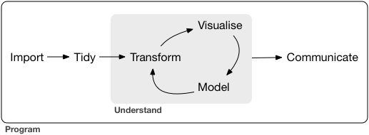
Getting data into R
Manually create it
Import it from a file
Text file: TXT, CSV, TSV
Excel: XLSX
Statistics program: SPSS, MATLAB, Stata
Databases: MySQL
JSON, HTML, XML
Gather it from the web
Connect to webpages, servers, or APIs
Webscraping
Workflow image from Garrett Grolemund & Hadley Wickham, R for Data Science. http://r4ds.had.co.nz/explore-intro.html. Licensed under CC BY-NC-ND.

Slide 12
Set your working directory
The working directory is the folder on your computer R will use for reading and writing files
> setwd("C:/Users/iakovakis/Desktop/r.workshop.files")
Put in quotation marks " "
Use forward slash: /

Slide 13
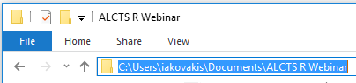
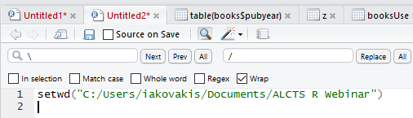
Set your working directory
You can copy/paste from directory window and do a Find \ Replace / in R Studio

Slide 14
Set your working directory
Print the current working directory to the console:
> getwd() [1] "C:/Users/iakovakis/Desktop/r.workshop.files"

Slide 15
Set your working directory
You can then use ./ as the root directory
> read_csv(file = "./data/books.csv")
will be the same as
> read_csv(file = "C:/Users/iakovakis/Documents/ALCTS R Webinar/data/books.csv")

Slide 16
Set your working directory
Suggested directory set up for R

Slide 17
Reading tabular data
Main functions for reading tabular data:
read_csv(): reads comma-separated values files

Slide 18
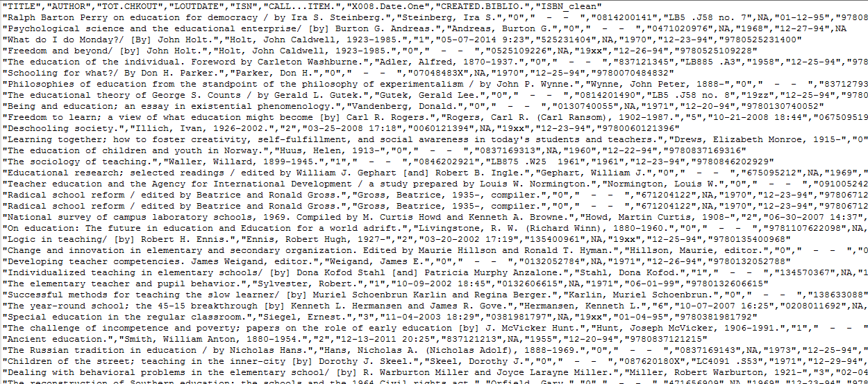
Structure of text data files
Text files use delimiters to separate data values
comma separated values (CSV) use commas
Tab separated values use tabs
Data values are typically in quotation marks
"TITLE", "AUTHOR", "TOT.CHKOUT"
"Macbeth", "Shakespeare", "25"
"Dracula", "Stoker", "15"
"1984", "Orwell", "18"

Slide 19
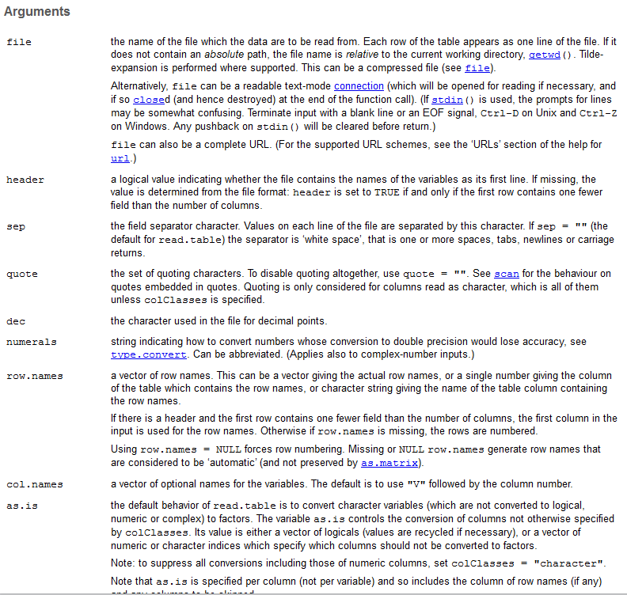
R functions take arguments
A function can take a specified number of arguments
Arguments can be found on the help page for that function
> ?read_csv

Slide 20
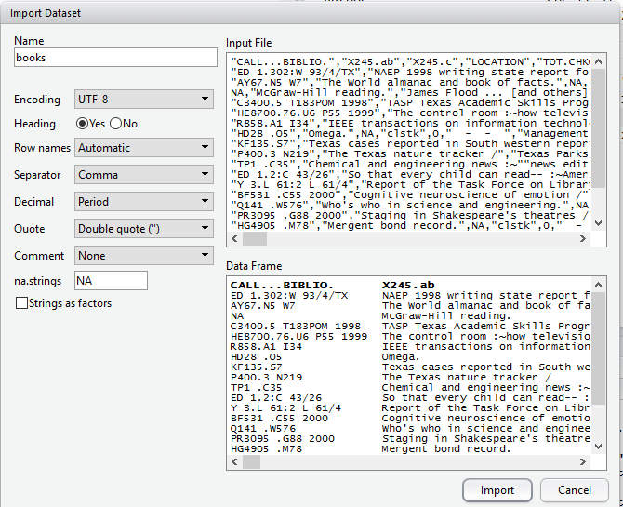

Reading tabular data
R Studio has an Import Dataset tool in the Environment Pane (upper right)
It runs the read.table() or read.csv() function

Slide 21
Reading Excel files
To read Microsoft Excel files, either:
Save your file in Excel as a CSV and load it in R with read_csv()
Or, use the readxl package in R
> install.packages("readxl")
> library("readxl")
> read_excel("./data/books.xlsx)

Slide 22
Tidying & transforming data

Slide 23
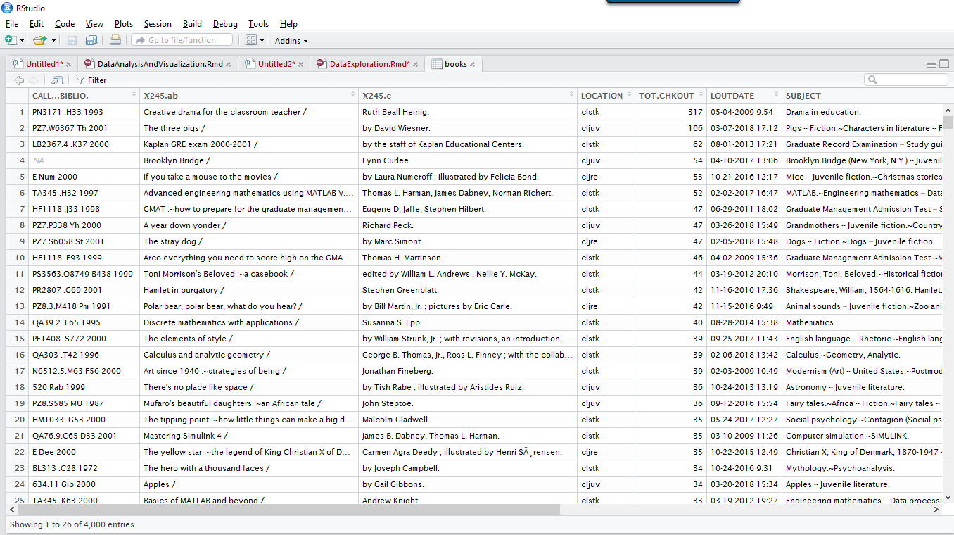
Exploring data frames
> View(books)

Slide 24
Exploring data frames
> dim(books)
[1] 4000 12
> nrow(books)
[1] 4000
> ncol(books)
[1] 12
Dimensions: 4,000 rows, 12 columns
Number of rows
Number of columns

Slide 25
Exploring data frames
> str(books)
'data.frame': 4000 obs. of 12 variables:
$ callnumber : chr "SI 1.2:Af 8/3" "HC110.C6 L852 1999" "HX91.O5 B57 1999" "I 20.47:P 93" ... $ title : chr "A human ideal in African art :~Bamana figurative sculpture /" "Untold millions :~secret truths about marketing to gay and lesbian consumers /" "Agrarian socialism in America :~Marx, Jefferson, and Jesus in the Oklahoma countryside, 1904-1920 /" "1:100 000-scale metric topographic map of Price, Utah, 1980 :~30 x 60 minute series (topographic) /" ...
$ author : chr "Kate Ezra." "Grant Lukenbill." "Jim Bissett." "United States Department of the Interior, Bureau of Indian Affairs." ...
$ LOCATION : chr "clusd" "clstk" "clstk" "clusd" ...
$ TOT.CHKOUT : int 0 0 1 0 0 0 0 0 1 0 ...
$ LOUTDATE : chr " - - " " - - " "03-04-2015 14:53" " - - " ...

Slide 26
Exploring vectors
Use the dollar sign $ to specify a variable in a data frame
> str(books$LOCATION)
chr [1:4000] "clstk" "clstk" "clstk" "clstk" "clstk"...

Slide 27
unique()
unique() returns all the distinct values in a variable
> unique(books$LOCATION)
[1] clcdr clchi clcir clcre clfhd clids cljre cljuv clref clrsd clstk clthe cltxd clua clusd
In this case, it displays all unique book location codes.

Slide 28
table()
table() returns frequency counts for a specified variable
> table(books$LOCATION)
clcdr clchi clcir clcre clfhd clids cljre cljuv clref clrsd clstk clthe cltxd clua clusd
11 35 1 3 350 8 136 217 186 1 2342 27 127 17 522
You can use it in combination with relational operators
> table(books$TOT.CHKOUT > 50)
FALSE TRUE
3993 7

Slide 29
duplicated()
duplicated() will give you a logical vector of duplicated values
> z <- c("111", "222", "111", "333", "444")
> duplicated(z)
[1] FALSE FALSE TRUE FALSE FALSE
> !duplicated(z)
[1] TRUE TRUE FALSE TRUE TRUE

Slide 30
duplicated()
Use duplicated() nested in table() to find out how many values are dupes
> table(duplicated(z))
FALSE TRUE
4 1
Use which() to identify the duplicated element
> which(duplicated(z))
[1] 3

Slide 31


Data manipulation with dplyr
dplyr was created by Hadley Wickham
A "grammar for data manipulation" that simplifies a number of critical data cleaning and transformation tasks
Photograph from Wikimedia at https://commons.wikimedia.org/wiki/File:Hadley-wickham2016-02-04.jpg. Licensed under CC BY-SA 4.0

Slide 32
Data manipulation with dplyr
rename(): rename variables
recode(): replace data values
filter(): create subsets of data
arrange(): sort data
select(): choose specific variables
mutate(): create new variables
summarize(): create summaries of data

Slide 33
Data manipulation with dplyr
To read thorough examples of dplyr functions, run in your console:
> vignette("dplyr")
Make sure to load the package
> library(dplyr)

Slide 34
dplyr functions
function(data frame, arguments what to do with the data frame) returns a data frame
rename(books, title = X245.ab)

Slide 35
dplyr::rename
> names(books)
[1] "CALL...BIBLIO." "X245.ab" "X245.c" "LOCATION" "TOT.CHKOUT" "LOUTDATE"
[7] "SUBJECT" "ISN" "CALL...ITEM." "X008.Date.One" "BCODE2" "BCODE1"

Slide 36
dplyr::rename
Where does X245.ab come from?
245|ab
R doesn’t allow variables to start with numbers, and a period is the only valid punctuation, so R automatically converted it.
Similarly, CALL #(ITEM) becomes CALL...ITEM.

Slide 37
dplyr::rename
rename(): Rename variables
Remember, you have to assign (<-) your function to books in order to overwrite the object
> books <- rename(books
, title = X245.ab
, author = X245.c
, callnumber = CALL...BIBLIO. , isbn = ISN
, pubyear = X008.Date.One
, subCollection = BCODE1
, format = BCODE2)

Slide 38
dplyr::recode
recode(): replace data values
First, use unique() to see all elements in a variable
> unique(books$subCollection)
[1] "u" "-" "j" "r" "b" "a" "s" "c" "t" "z"

Slide 39
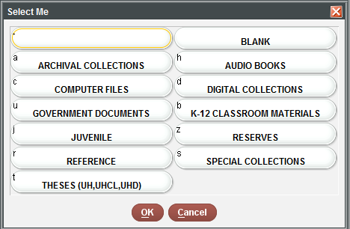
dplyr::recode
> books$subCollection <- recode(books$subCollection
, "-" = "general collection"
, u = "government documents"
, r = "reference"
, b = "k-12 materials"
, j = "juvenile"
, s = "special collections"
, c = "computer files"
, t = "theses"
, a = "archives"
, z = "reserves")

Slide 40
dplyr::recode
> table(books$subCollection)
archives computer files general collection government documents juvenile
14 8 2296 1049 353
K-12 materials reference reserves special collections theses
35 157 12 49 27

Slide 41
Subsetting data frames
In the same way you use brackets [] to subset vectors, you also use them to subset data frames.
> scale <- c("do", "re", "mi", "fa", "so")
> scale[1]
[1] "do"
However, vectors have only one direction, but dataframes have two.
myDataFrame[row, column]

Slide 42
Subsetting data frames
> books[5, 2]
[1] "Fear of intimacy / "
Can also use column names:
> books[5, c("title", "TOT.CHKOUT")]
title TOT.CHKOUT
5 Fear of intimacy / 7

Slide 43
Subsetting data frames
Subsetting with brackets is good to know, but the dplyr package provides a much easier way with filter()

Slide 44
dplyr::filter
Some of this data includes serials, videos, and other types of materials classified in the format column.
First, use table() to see how many elements are in the variable
> table(books$format)
book cd-rom database e-gov doc image kit/object map microform
3078 3 1 8 2 1 29 340 serial
538
Most of the items are books and serials, but there’s also some microforms.

Slide 45
dplyr::filter
filter(): Keep rows matching criteria
> booksOnly <- filter(books, format == "book")

Slide 46
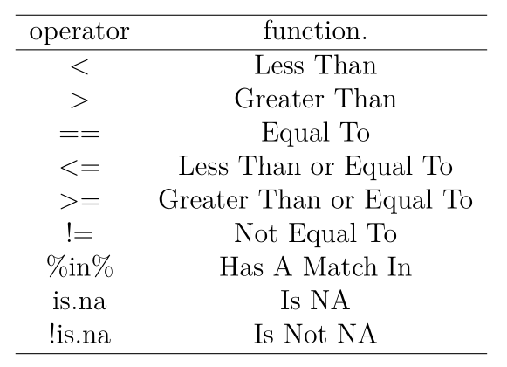
Relational Operators in R
> help(Comparison)

Slide 47
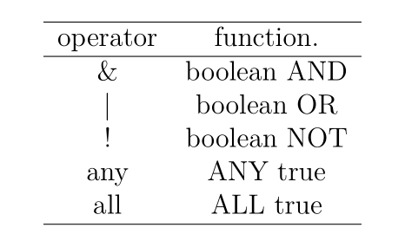
Logical Tests in R
> help(Logic)

Slide 48
dplyr::filter
filter on multiple variables:
books and serials
> books_and_serials <- filter(books , format == "book" | format == "serial")

Slide 49
dplyr::filter
filter on multiple variables:
books with 1 or more checkouts
> bookCheckouts <- filter(books , format == "book" , TOT.CHKOUT > 0)

Slide 50
dplyr::filter
How many are there?
> nrow(bookCheckouts)
[1] 3616
What percentage is that of all books?
> nrow(bookCheckouts)/nrow(booksOnly) * 100
[1] 63.93762
…not bad!

Slide 51
dplyr::filter
You can also use filter() to get rid of NA values
filter(books, complete.cases(callnumber))
or duplicate values
filter(books, !duplicated(title))
the exclamation mark means not duplicated

Slide 52
dplyr::select
select(): Keep (or remove) only the variables you mention
> booksTitleCheckouts <- select(books, title, TOT.CHKOUT)
> dim(booksTitleCheckouts)
[1] 10000 2

Slide 53
dplyr::select
Specify the variables you want to remove with a -
> books <- select(books, -CALL...ITEM.)

Slide 54
dplyr::arrange
arrange(): Sort data by alphabetical or numerical order
> books <- arrange(books, title)
Use desc() to sort in descending order
> books <- arrange(books, desc(TOT.CHKOUT))

Slide 55
dplyr::mutate
mutate(): Create new variables
Use str_sub() from the stringr package to
extract the first character of the callnumber variable (the LC Class)
> booksLC <- mutate(books
, lc.class = str_sub(callnumber, 1, 1))

Slide 56
Putting it all together with %>%
> myBooks <- books %>%
filter(format == "book“
, TOT.CHKOUT > 0) %>%
select(title, TOT.CHKOUT) %>% arrange(desc(TOT.CHKOUT))
This does four things and is much more efficient & readable:
Gets only books with 1 or more checkouts
Selects only the title and checkout columns
Arranges the data by total number of checkouts

Slide 57
Write.csv
> write.csv(bookCheckouts
, “./bookCheckouts.csv
, row.names = F)
Writes your data frame to a CSV file in the directory and file name of your choosing.

Slide 58
You made it (again)!
Refer to the handouts for exercises and more in-depth explanations.

Slide 59
Session 3: Data Analysis & Visualization
We will run some analysis and visualization
Wednesday, 5/30/2018
2:00 PM-3:00 PM (Eastern)
1:00 PM-2:00 PM (Central)
12:00 PM-1:00 PM (Mountain)
11:00 AM-12:00 PM (Pacific)
http://www.ala.org/alcts/confevents/upcoming/webinar/IntrotoR

Slide 60
Questions?

